Slide 1
Azure Training Day Migrating web applications to Azure

Slide 2
Overview of Azure web app migration
Part 1 of 5 in the Migrate web apps to Azure series
MSUSDev@Microsoft.com
Sep, 2019

Slide 3
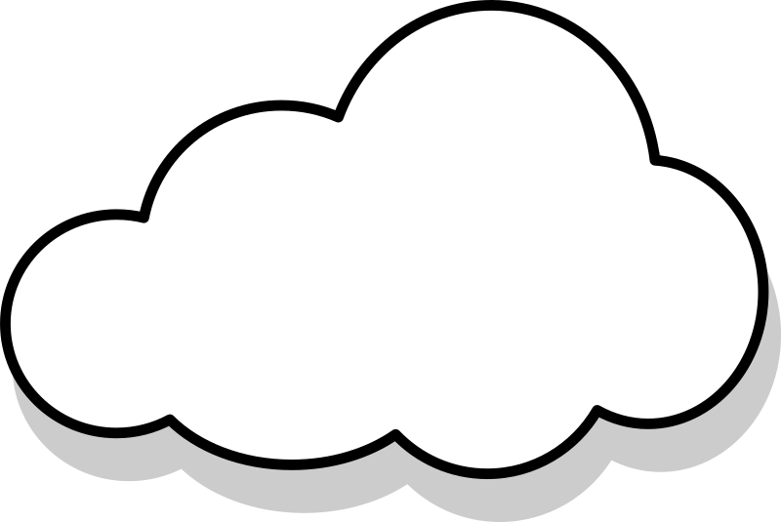
About us…
Fareed Muhammad Khan
National Solutions Director – Azure, US Regulated Industries
Matthew Calder (macalde@microsoft.com)
Sr. Product Marketing Manager – Azure, US Marketing and Operations
For questions or help with this series
MSUSDev@Microsoft.com
For the lab guides and sample code
https://github.com/MSUSDEV/Migrating-web-apps-to-Azure

Slide 4
Setting the scene

Slide 5
Overview of the workshop
About the workshop content…
About: This series, Migrate web apps to Azure, takes you through the first 5 modules of a longer, 9 part workshop that builds a proof of concept (POC) that transforms an existing ASP.NET-based Web application (SimplCommerce) to a container-based application.
For the purpose of this training, we will focus on the steps that take you through deploying and migrating web applications to Azure Web Apps: automating Azure resources deployments using Visual Studio and Azure Resource Manager (ARM) templates, performing proper assessments and the tools Microsoft offers to help in this migration preparation phase, Microsoft SQL database migration to SQL Azure PaaS, as well as deploying and migrating web applications to Azure Web Apps.
Target Audience: The workshop is targeted to Cloud Architects, Cloud Solution designers, developers and IT sysadmins, CIO’s, CTO’s and anybody else who is interested in learning about Azure, containers, application cloud migration and digital transformation.
Focus of the workshop (40%) is getting hands-on experience, complemented with webcast presentations. Time Estimate: 9 hours (+/- 6 hours presentations, 3 hours of optional hands-on labs for attendees)

Slide 6
Workshop Agenda - Presentations
What we will talk about…
Module 1: Digital App Transformation with Azure
Module 2: Running Azure Infrastructure and execute Lift & Shift Migrations
Module 3: Performing proper assessments to smooth Azure Migrations
Module 4: Why and how migrating databases to Azure PaaS
Module 5: Migrating to Azure App Services – Azure Web Apps (.NET)

Slide 7
Workshop Agenda – Hands On Labs
Learn by doing…
Module 2: Running Azure Infrastructure and execute Lift & Shift Migrations
Lab 1: Deploy an Azure VM Infrastructure using ARM-Templates
Module 3: Performing proper assessments to smooth Azure Migrations
Lab 2: Using Azure assessment tools
Module 4: Why and how migrating databases to Azure PaaS
Lab 3: Migrating SQL Databases to Azure using Database Migration Assistant
Module 5: Migrating to Azure App Services – Azure Web Apps (.NET)
Lab 4: Publishing application source code to Azure Web Apps using Visual Studio 2019

Slide 8
Technical Requirements
What you need…
<Could vary based on the actual delivery-method>, but overall:
Client workstation running recent Windows, Linux or Mac OS and latest internet browser
Access to ports 80 (HTTP), 443 (HTTPS) and 3389 (Remote Desktop)
Full Azure subscription (MSDN, AzurePass, Paid subscription, AE, CSP,…), where you have Owner permissions on subscription level
Lab consumption estimate: $15-35

Slide 9
Questions and HOL support
MSUSDev@microsoft.com
Subject: Azure Developer Series – migrate web apps
Response Time: within 24 hours
Check GitHub for FAQ and Updates: https://github.com/MSUSDEV/Migrating-web-apps-to-Azure

Slide 10
Questions
Landing
Spot
“…If you want good answers, ask better questions…”
© Randy Glasbergen

Slide 11
Digital Transformation
Why and How does Azure support digital transformation

Slide 12
Key Objectives
What you will learn in this section
Digital Transformation
The journey to the cloud
Introduction to Containers
Introduction to Microservices
Technologies covered in this workshop series

Slide 13
What is this digital transformation everybody talks about?
Digital Transformation
Digital transformation helps organizations to improve efficiency and effectiveness of service/products, using the latest available technology.
Instead of replicating an existing platform, we use technology to transform that service/product into something significantly better.

Slide 14
Digital Transformation
Digital Transformation is using technology to radically change the datacenter
Don’t focus on the location of the technology, but rather focus on the use of technology
Embrace the continuous flow of updates and changes, and keep up with it.
What is
digital transformation
for IT Admins?

Slide 15
Digital Transformation
Digital Transformation is using technology to radically change your application landscape
Don’t focus on dev language, but rather focus on the capabilities a language brings
Importantly, think broader than just the application,the data,… but how it runs and scales
What does
digital transformation mean
for Developers?

Slide 16



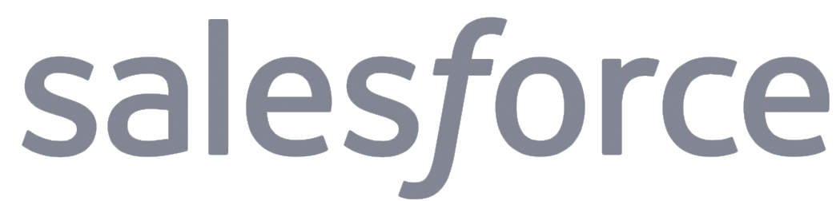
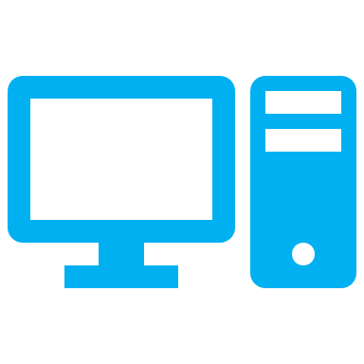


Digital Transformation is continuously evolving
Physical Datacenter
Mobility and SaaS
Virtualized Datacenter
BIG Data Solutions
Virtualized Datacenter in public cloud
Artificial Intelligence

Slide 17
What is App Modernization?
IT Simplification
Standardize on the platform and solutions
Migrate away from legacy systems
Integrate automation
GROWTH ENABLEMENT
Focus on the business growth, not the technology
Easily allow for business scale
Provide business Insights and Analytics
AGILITY
Faster deployment to different environments
Aligned deployment / Less mistakes
DevOps practices using continuous delivery
Reducing TCO
Downsize on infrastructure running cost
Minimize ongoing maintenance efforts
Make applications portable

Slide 18
What is the right size of
servers for my business needs?
How do I deploy new code to my server?
What media should I
use to keep backup?
What happens in case of
server hardware failure?
Which packages should be on my server?
What size of servers
should I buy?
Who monitors
my App?
How often should I backup my server?
How can I scale my app?
How can I increase server utilization?
Who has physical
access to my servers?
Which OS should I use?
Do I need secondary network connection?
Are my server in a
secure location?
What happens if the
power goes out?
Who monitors
my Servers?
Do I need a UPS?
What storage I need to use?
How many servers
do I need?
How can I dynamically configure my app?
It takes how long to provision a new server?
How often should
I patch my servers?
The “evolution” of application platforms
On-Premises

Slide 19
What is the right size of servers for my business needs?
How can I increase server utilization?
How many servers do I need?
How can I scale my app?
How often should I patch my servers?
How do I deploy new code to my server?
How often should I backup my server?
Which OS should I use?
Which packages should be on my server?
Who monitors my App?
The “evolution” of application platforms
On-Premises
IaaS

Slide 20
What is the right size of “servers” for my business needs?
How can I increase “server” utilization?
How many “servers” do I need?
How can I scale my app?
What are containers?
The “evolution” of application platforms
On-Premises
IaaS
PaaS

Slide 21
How do I (re)architect my app?
Serverless, the platform for next gen apps
The “evolution” of application platforms
On-Premises
IaaS
PaaS
Serverless

Slide 22
The journey to the cloud
Apps
Data & Intelligence
Migration & Modernization
Cloud-Native
SaaS
On-premises
Rehost
Refactor
Rearchitect
Rebuild/New
Replace
Infrastructure
DevOps
Deliver faster and more reliably

Slide 23
The journey to the cloud
SaaS apps
Serverless
Replace
Microservices
From on-premises systems to cloud applications
Containers
Rebuild or New
VMs
Rearchitect
Existing on-premises infrastructure and applications
Refactor
Rehost
App Modernization
Digital Transformation – started years ago already

Slide 24
The Cloud has become mainstream
In 2012: “if” we are moving to the cloud In 2017: “when” and “how” we are moving to the cloud
+200B
Y2020
$122.5B
Y2017
$60B
Y2015
$20B
Y2012
(*) Source: International Data Corporation - 2017

Slide 25
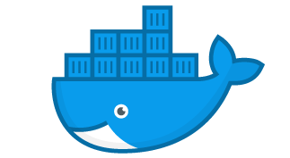
What are containers?
Virtual machines
Containers
Container
Container
Container
Container
App
App
App
App
App
App
App
Binaries & Libraries
Binaries & Libraries
Binaries & Libraries
Container
Container
Container
Container
Guest VM Operating System
Guest VM Operating System
Guest VM Operating System
App
App
App
App
Binaries & Libraries
Binaries & Libraries
Hypervisor
Docker Engine
Host Operating System
Host Operating System
Physical Server
Physical Server
Virtualize the hardware
VMs as units of scaling
Hypervisor dependent
Not easily movable
Virtualize the operating system
Applications as units of scaling
Platform independent
Easily movable across environments (on-premises, multi-cloud)

Slide 26

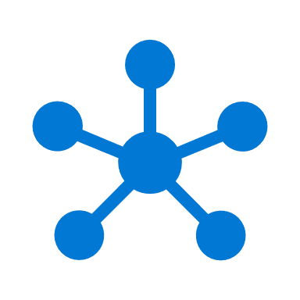

What are Microservices?
Monolithic
Microservices
Large, all-inclusive app
Small, independent services
From Monolithic to independent modules
App
App
App
Complex, larger, all-inclusive systems are rearchitected to simpler, smaller, single-purposed modules. Still resulting in a full-fletched application landscape
Each module runs a single functionality
These service modules are highly decoupled building blocks that are small enough to implement a single functionality but together can form larger systems
Independently versioned, deployed & scaled
With a microservices architecture, developers can create, manage and improve application services independently, even using different languages
Containers provide the consistent format and isolation desired by microservices.

Slide 27
How do containers help in app modernization?
Containers are stand-alone, smaller silos of app instances, running at scale
Container
Container
App
App
App
Binaries & Libraries
Container
Container
Guest VM Operating System
App
App
Existing/New Applications (=rehome)
Lift and shift to containers (= rehost, refactor)

Slide 28
How do containers help in app modernization?
Containers are not the end-state, but an in-between path to Microservices
Container
Container
App
App
App
Binaries & Libraries
Container
Container
Guest VM Operating System
App
App
Existing/New Applications (=rehome)
Lift and shift to containers (= rehost, refactor)
Microservices (=rearchitect)

Slide 29
Questions
Landing
Spot
“…If you want good answers, ask better questions…”
© Randy Glasbergen

Slide 30

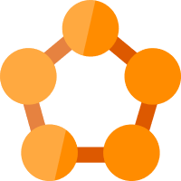




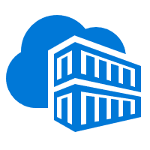
Running Containers on Azure: a full set of choices
App Service
Service Fabric
Kubernetes Service
Container Instance
Partner Ecosystem
Deploy web apps or APIs using containers in a PaaS environment
Modernize .NET applications to microservices using Windows Server containers
Elastically burst from your Azure Kubernetes Service (AKS) cluster
Bring your Partner solutions that run great on Azure
Scale and orchestrate Linux containers using Kubernetes
Azure Container Registry
Docker Hub
Choice of developer tools and clients

Slide 31
Containers on Azure: covered in this workshop
App Service
Kubernetes Service
Container Instance
Docker CE
Running Docker Containers as Azure Web Apps
Azure Container Services (ACS) with Kubernetes + Azure Kubernetes Service
Running Stand-Alone Docker Containers as a Container Instance
Docker Community Edition on Windows Server 2016/2019
Azure Container Registry
Docker Hub
Choice of developer tools and clients

Slide 32
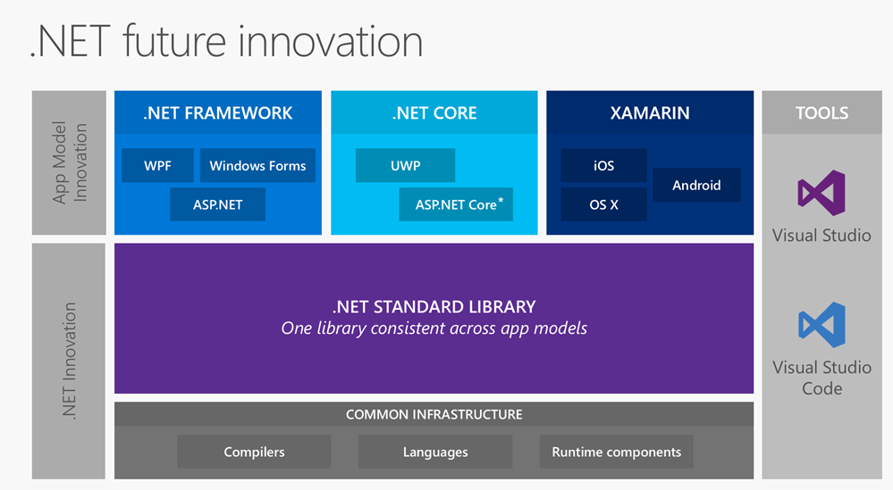
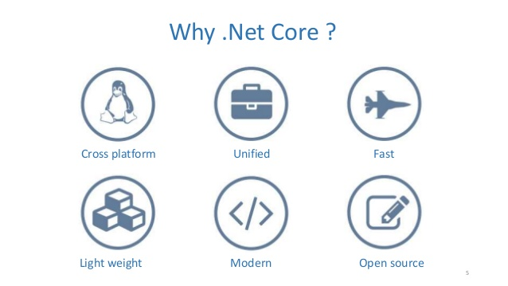
Isn’t a dotnet app the « easy » example?
.NET is used for 60% of all global Enterprise Web applications
Containers are not development language specific
Remember, digital transformation is focusing on the evolution, not the technology or language behind it
Examples we use in this workshop are just examples

Slide 33
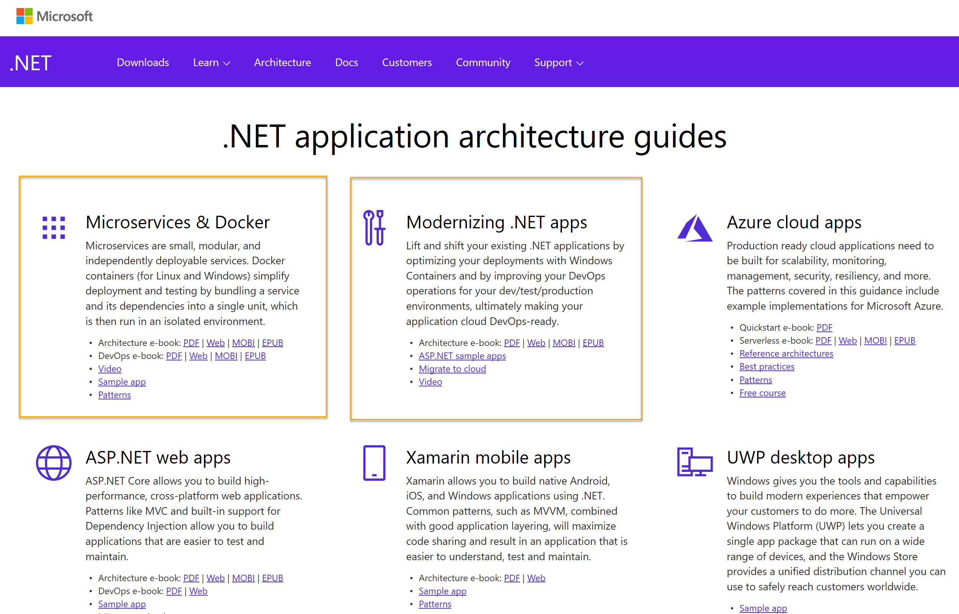
ASP.Net application architecture guides
https://www.microsoft.com/net/learn/dotnet/architecture-guides
Microservices
Docker
Windows Containers
Azure Containers

Slide 34
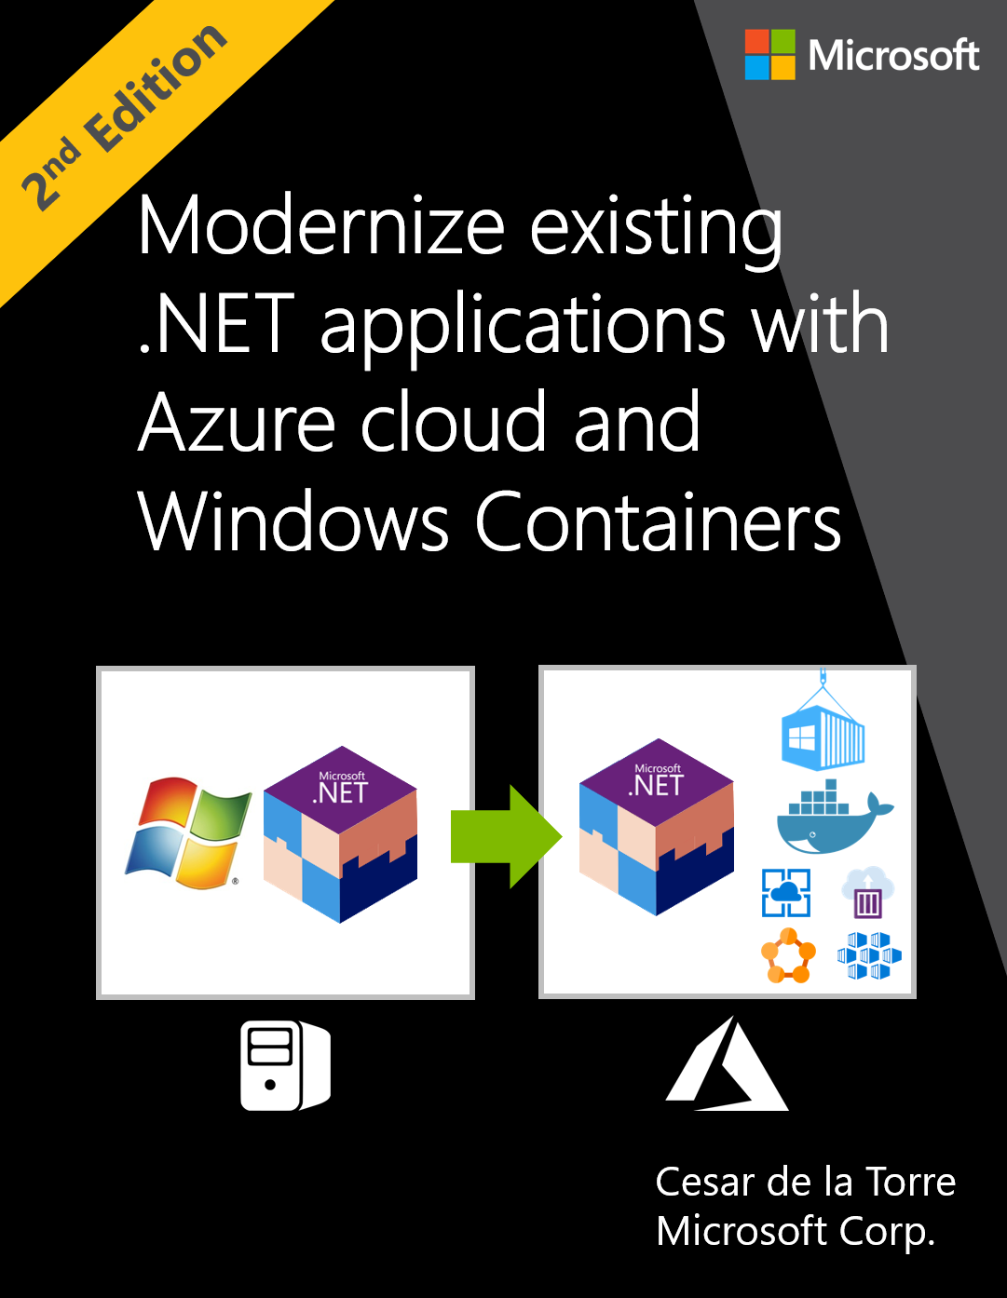
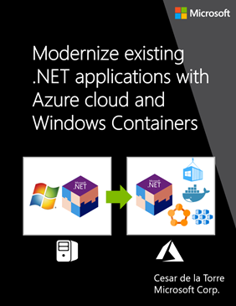
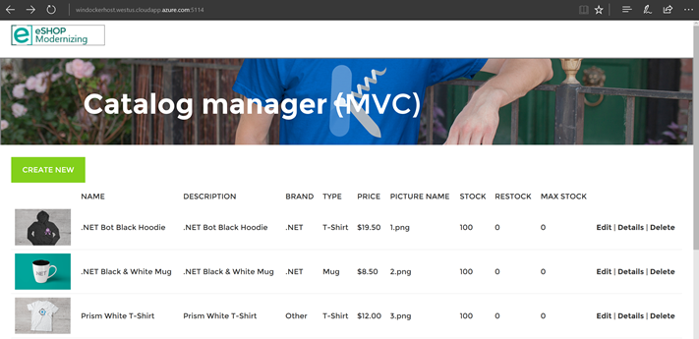
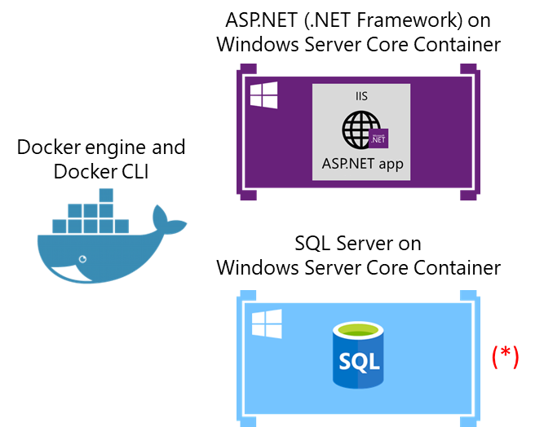
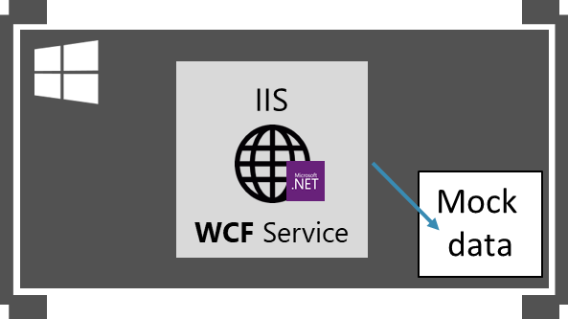
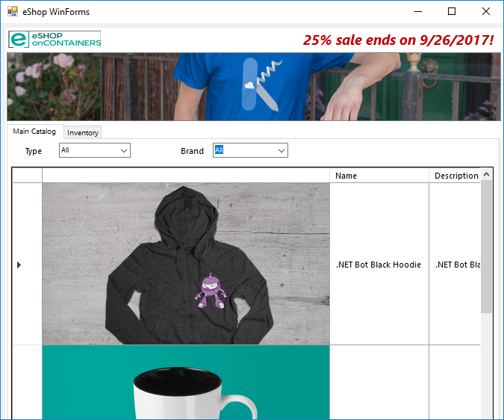
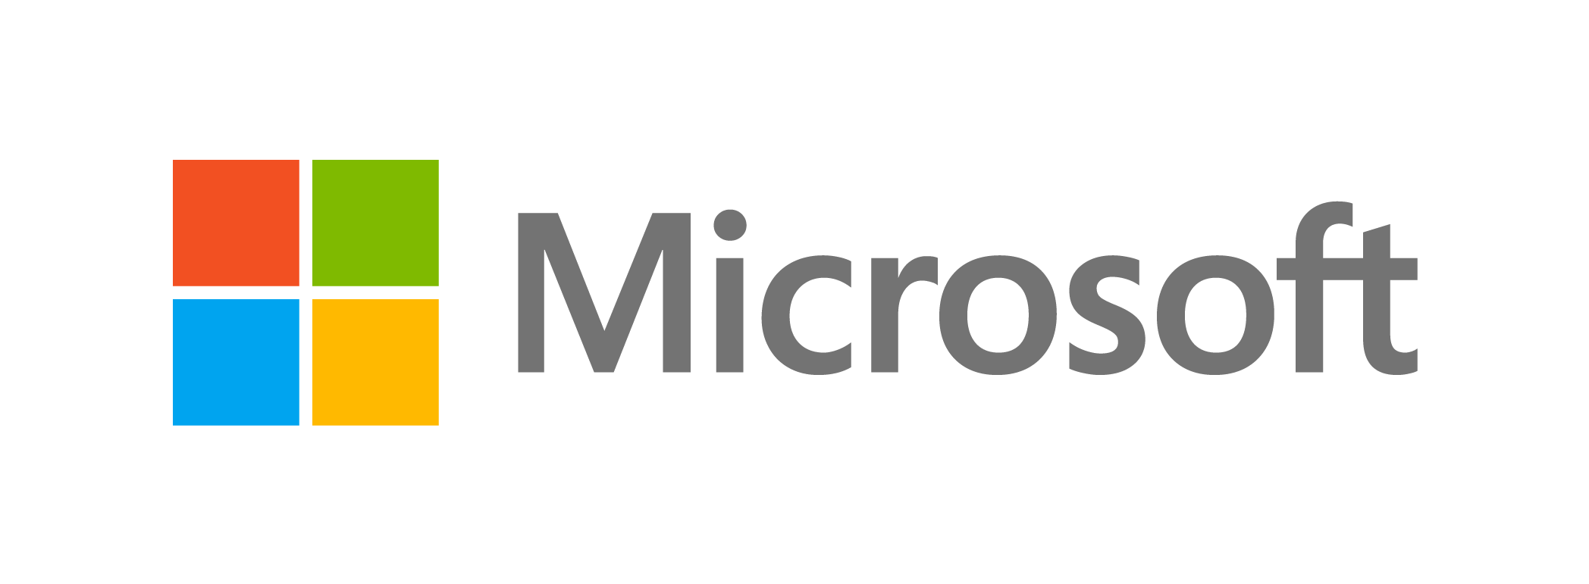
Guide/eBook and sample apps on Modernize with Windows Containers
eBook/Guide
Sample Apps for modernization
Intended for .NET developers and solution architects
Prescriptive guidance on how to modernize your existing .NET apps and migrate to the Azure cloud
Accompanied with journeys of modernizing existing ASP.NET web apps (WebForms, MVC) and N-Tier apps (WCF + WinForms) on eShopModernizing repository.
Client UI apps
Architecture
Browser
WinForms
ASP.NET
MVC &
Web Forms
WCF service on
Windows Container
WinForms
https://aka.ms/liftandshiftwithcontainersebook
https://github.com/dotnet-architecture/eShopModernizing

Slide 35
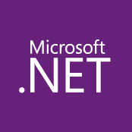
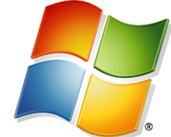
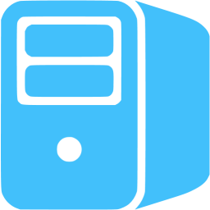
Maturity model for .Net applications
Existing apps
.NET web apps (on-premises)
Monolithic or N-Tier
architectures
Relational Database
On-premises
Architected for the cloud, needs new code

Slide 36
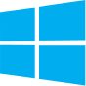
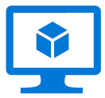
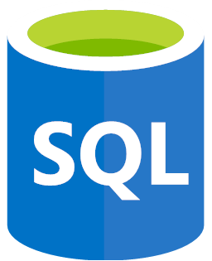
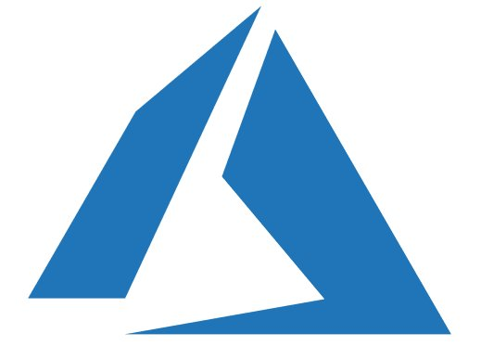
Maturity model for .Net applications
Existing apps
.NET web apps (on-premises)
Cloud
Infrastructure-Ready
Monolithic or N-Tier
architectures
Monolithic or N-Tier
architectures
Relational Database
IaaS
(Infrastructure as a Service)
VMs
On-premises
Azure
Base Cloud Environment and cross-cutting concerns: Network, Hybrid-cloud, Identity/Auth, Cost control and Operations model
Migrate / Rehost

Slide 37

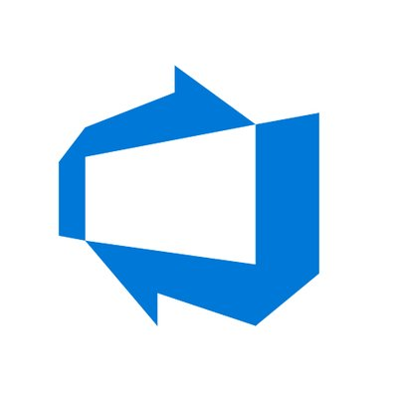
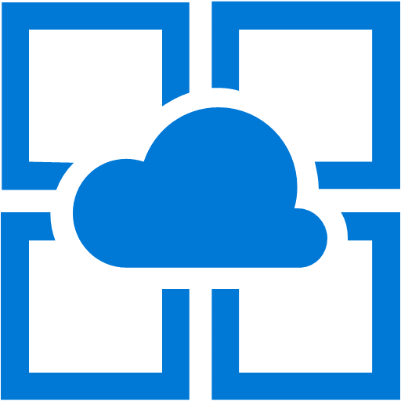
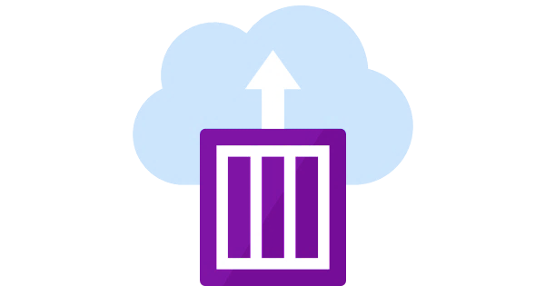
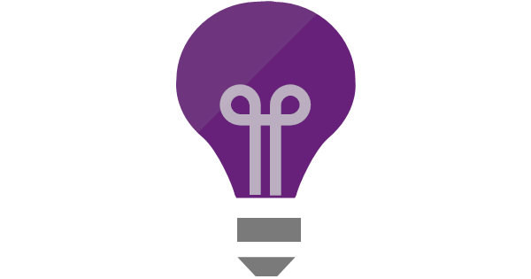
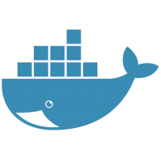
Maturity model for .Net applications
Existing apps
.NET web apps (on-premises)
Cloud
Infrastructure-Ready
Cloud-Optimized
PaaS
Monolithic or N-Tier
architectures
Monolithic or N-Tier
architectures
Monolithic or N-Tier
architectures
Relational Database
IaaS
(Infrastructure as a Service)
Managed services
VMs
And
Windows Containers
On-premises
Azure
Azure
Base Cloud Environment and cross-cutting concerns: Network, Hybrid-cloud, Identity/Auth, Cost control and Operations model
Migrate / Rehost
Modernize
Minimal code changes

Slide 38
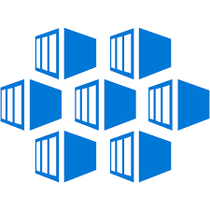
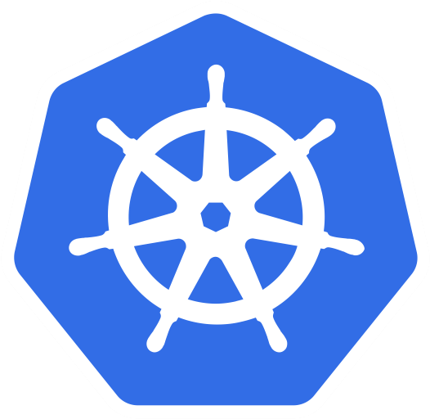
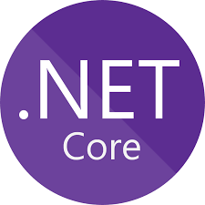
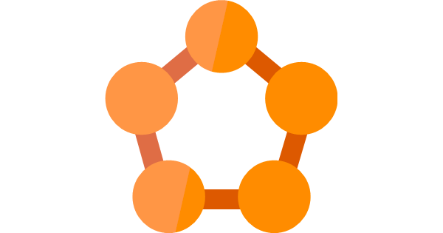
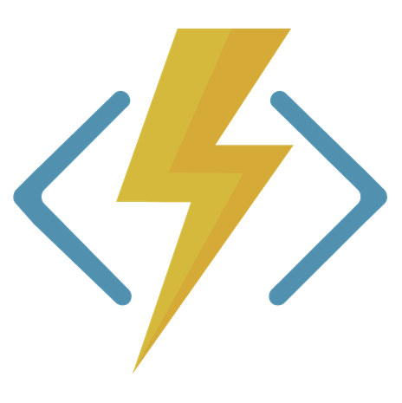

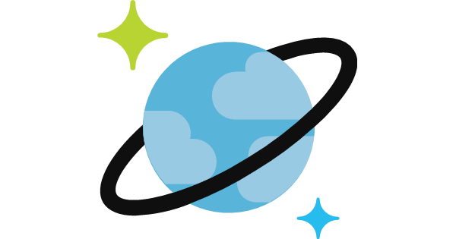
Maturity model for .Net applications
Existing apps
.NET web apps (on-premises)
Cloud
Infrastructure-Ready
Cloud-Optimized
PaaS
Cloud-Native
PaaS for microservices and serverless
Monolithic or N-Tier
architectures
Monolithic or N-Tier
architectures
Monolithic or N-Tier
architectures
Microservices and serverless architectures
Relational Database
IaaS
(Infrastructure as a Service)
Managed services
VMs
PaaS for containerized microservices
+ Serverless computing
+ Managed services
And
Windows Containers
On-premises
Azure
Azure
Azure
Base Cloud Environment and cross-cutting concerns: Network, Hybrid-cloud, Identity/Auth, Cost control and Operations model
Migrate / Rehost
Modernize
Minimal code changes
Architected for the cloud, needs new code

Slide 39
Maturity model for .Net applications
Migration to Web Apps / SQL PaaS
Cloud-Optimized
PaaS
Cloud-Native
PaaS for microservices and serverless
Existing apps
.NET web apps (on-premises)
Cloud
Infrastructure-Ready
Monolithic or N-Tier
architectures
Monolithic or N-Tier
architectures
Monolithic or N-Tier
architectures
Microservices and serverless architectures
Starting point for this workshop
IaaS
(Infrastructure as a Service)
Managed services
Relational Database
VMs
PaaS for containerized microservices
+ Serverless computing
+ Managed services
And
Windows Containers
Migration to Docker / Container Services
On-premises
Azure
Azure
Azure
Base Cloud Environment and cross-cutting concerns: Network, Hybrid-cloud, Identity/Auth, Cost control and Operations model
Migrate / Rehost
Modernize
Minimal code changes
Architected for the cloud, needs new code

Slide 40
Azure Compute Decision Tree for .Net Framework app migration
Azure App Service
ASP.NET
MVC app
Web Forms app
App has dependencies?
Azure Virtual Machines
NO
Web API Service
SignalR Service
YES
Web Pages app
Quick Migration Process?
Windows Containers on Azure VMs
WCF Service
YES
NO
Windows Containers on Azure Container Services (ACS)
Windows Containers on Azure Service Fabric
Dependencies can be documents, file system, COM-objects,… While containers support a quick migration path, since no code needs to be changed, it has a more complex learning curve than migration to Azure VMs

Slide 41
Section Take-Aways
Containers are a strategic way to modernize your existing .Net Framework applications
Azure provides different choices that enable app modernization
Azure natively provides several container services and orchestrators

Slide 42
Questions
Landing
Spot
“…If you want good answers, ask better questions…”
© Randy Glasbergen

Slide 43
Next Module…
Running Azure Infrastructure and performing VM Lift & Shift migrations
@pdtit @007FFFlearning

Slide 44
Thank You

